Slide 1
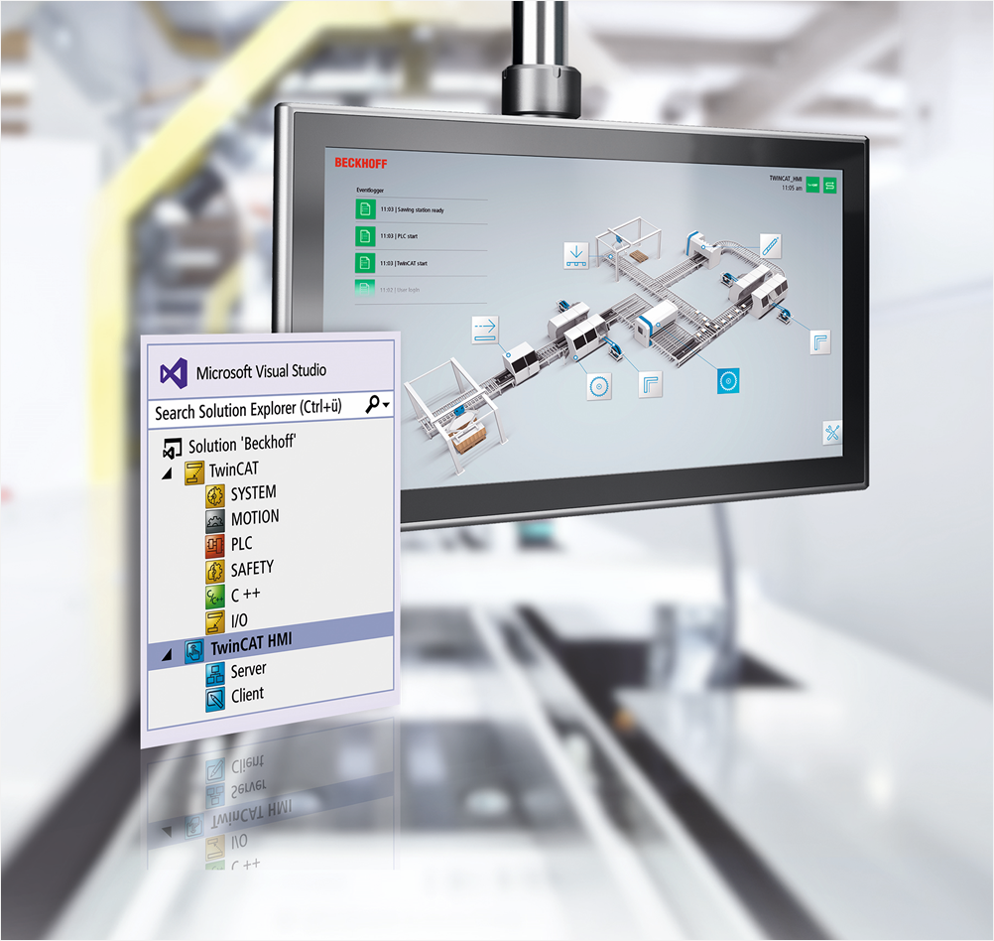
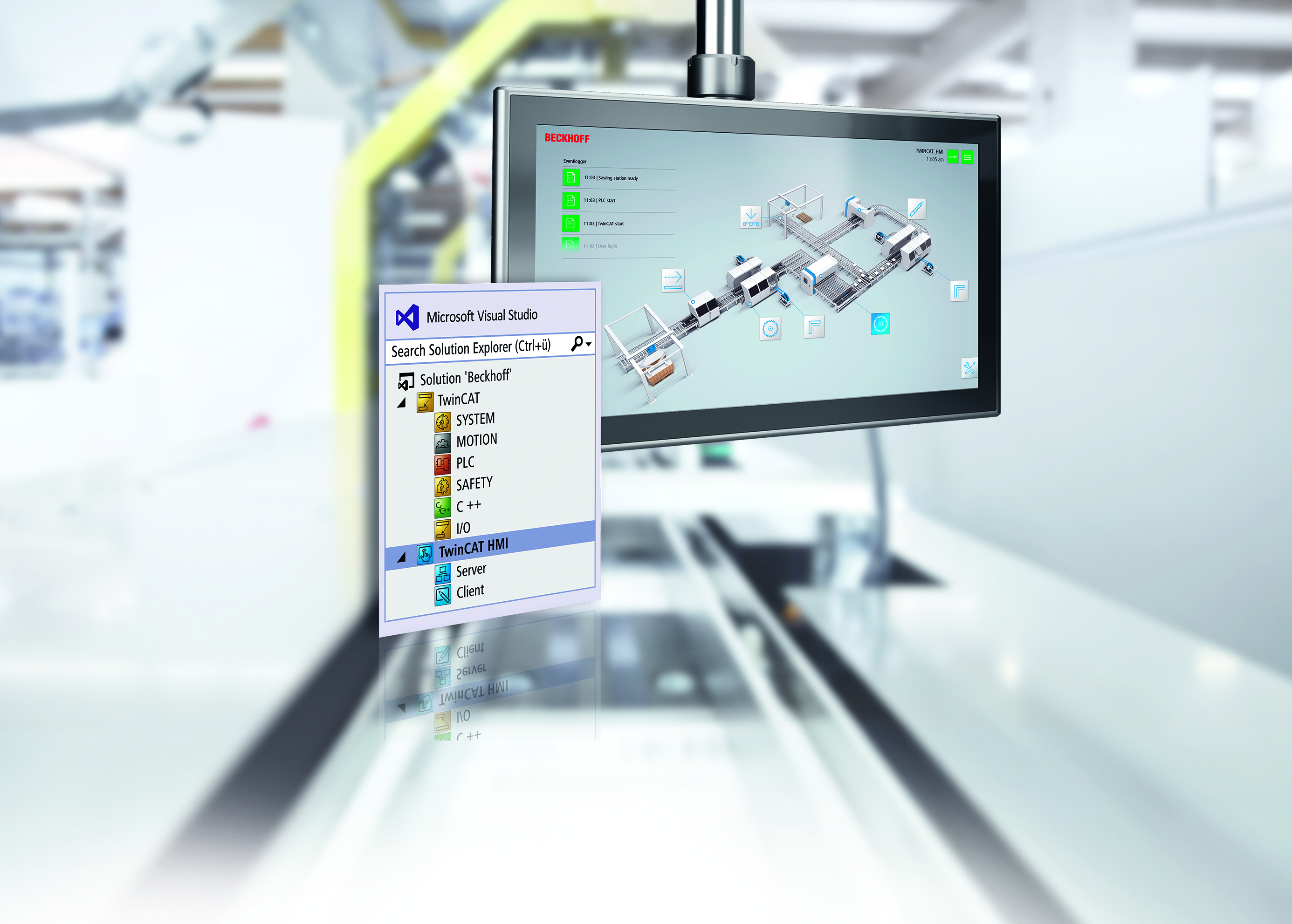
TwinCAT HMI Overview
Dev Vajaria

Slide 2
TwinCAT HMI Agenda
Introduction
Engineering
Architecture
Scenarios
Products
Features
What’s New

Slide 3
TwinCAT HMI Agenda
Introduction
Engineering
Architecture
Scenarios
Products
Features
What’s New

Slide 4

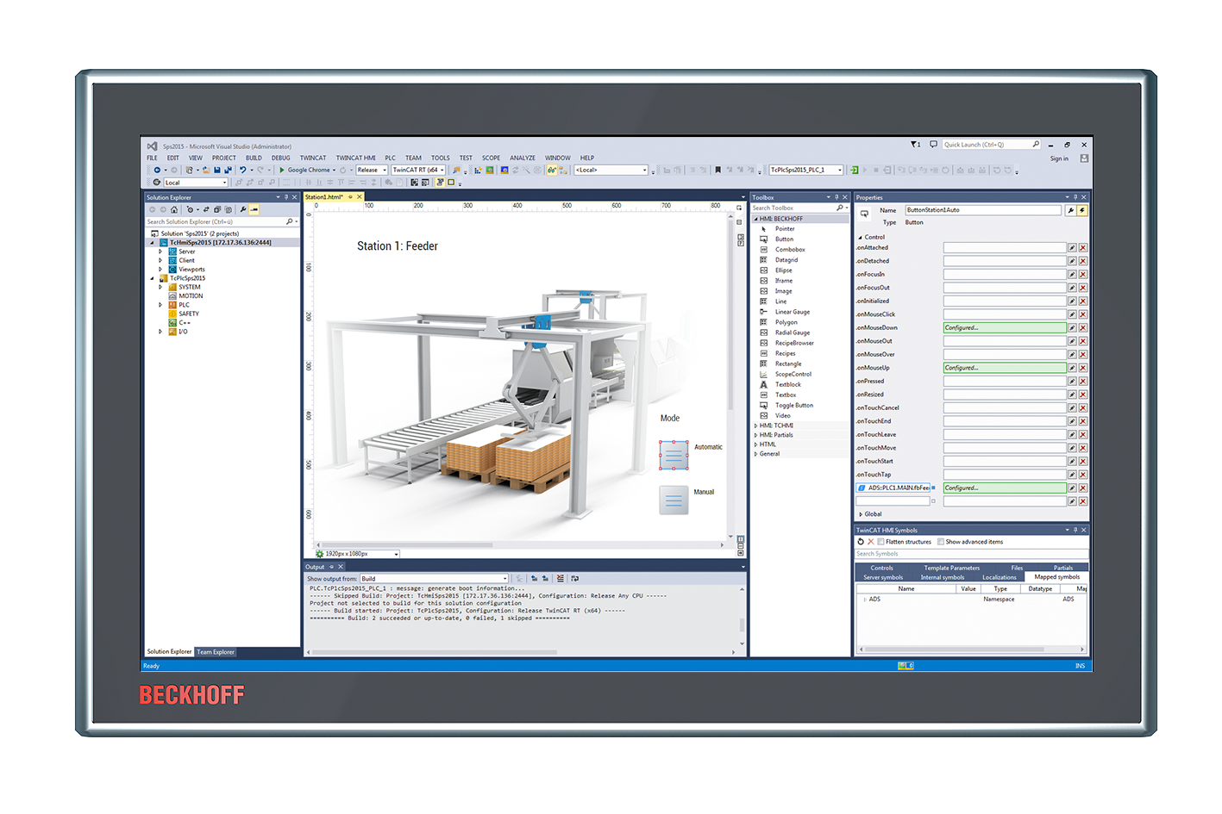

TwinCAT HMI | Introduction Technology
Platform
independent
Responsive
Future-proof
Performant

Slide 5




TwinCAT HMI | Introduction Components
TwinCAT HMI Creator
TwinCAT HMI Framework
TwinCAT HMI Server
TwinCAT HMI Client (HTML5-Browser)

Slide 6
TwinCAT HMI Agenda
Introduction
Engineering
Architecture
Scenarios
Products
Features
What’s New

Slide 7

TwinCAT HMI | Engineering Visual Studio® Integration
One engineering tool
Source code control
Live engineering

Slide 8

TwinCAT HMI | Engineering WYSIWYG-Editor
Graphical editor
Creation via Drag & Drop possible
Standard controls
Create own Users controls
Actions and Conditions Editor
User Management
Language and unit Management
Recipe Management
Alarming

Slide 9
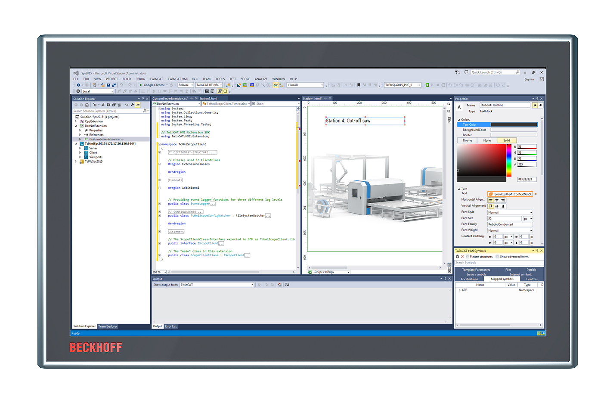
TwinCAT HMI | Engineering Extensibility
Framework Controls
JavaScript / TypeScript
3rd party
Server Extensions
C# .NET
C# .NET Core (VS2019)

Slide 10
TwinCAT HMI Agenda
Introduction
Engineering
Architecture
Scenarios
Products
Features
What’s New

Slide 11
TwinCAT HMI | Architecture Architecture during runtime
TwinCAT HMI Client
TwinCAT HMI Project
TwinCAT HMI Framework
Pages
Logic
…
Controls
API
…
HTTP(S)
WS(S)
TwinCAT HMI Server
WWW Root
TwinCAT HMI Server Extension
Content
Framework
Protocols
Events
…
ADS
ADS
TwinCAT Runtimes
3rd Party Runtimes

Slide 12
TwinCAT HMI Agenda
Introduction
Engineering
Architecture
Scenarios
Products
Features
What’s New

Slide 13
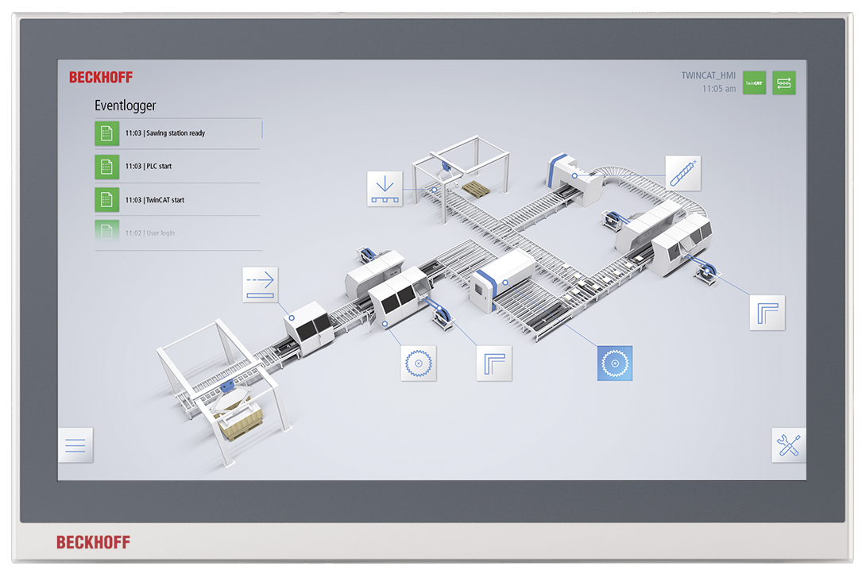
TwinCAT HMI | Scenarios Local client
Panel
DVI/USB
TwinCAT HMI Client
TwinCAT HMI Server
TwinCAT Runtime
PC

Slide 14
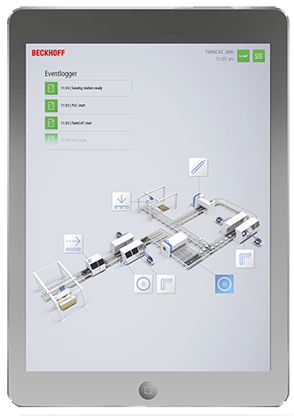
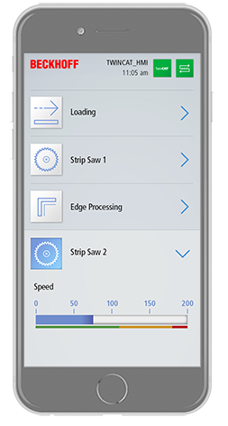
TwinCAT HMI | Scenarios Multi-client
Panel PC
Mobile Device
Mobile Device
TwinCAT HMI Client 1
TwinCAT HMI Client 2
TwinCAT HMI Client 3
WebSockets
TwinCAT HMI Client
TwinCAT HMI Server
TwinCAT Runtime
Panel PC

Slide 15
TwinCAT HMI | Scenarios Multi-runtime
Panel PC
Mobile Device
TwinCAT HMI Client 1
TwinCAT HMI Client 2
WebSockets
PC
TwinCAT HMI Server
ADS
PC
PC
PC
TwinCAT Runtime 1
TwinCAT Runtime 2
TwinCAT Runtime n

Slide 16
TwinCAT HMI Agenda
Introduction
Engineering
Architecture
Scenarios
Products
Features
What’s New

Slide 17
TwinCAT HMI | Products Products
TE2000 TC3 HMI Engineering
HMI Engineering environment integrated in Visual Studio
TF2000 TC3 HMI Server
One Client (Browser) and one Target (ADS) connection integrated
TF20x0 TC3 HMI Clients Pack
Extension of the number of concurrent client connections
TF20x0 TC3 HMI Targets Pack
Extension of the number of concurrent target connections

Slide 18
TwinCAT HMI | Products Products
TF2110 TC3 HMI OPC UA
Vendor-independent communication protocol
TF2200 TC3 HMI Extension SDK
Integration of custom .NET business logic
TF2300 TC3 HMI Scope
Integration of TwinCAT Scope

Slide 19

TwinCAT HMI | Products Business Model
Licensing is not based on the number of tags!
HMI Engineering is free of charge
Including updates and support
Licensing is based on
Platform level (like TC3) of TC HMI Server
Amount of clients and targets
No count of tags
Optional
TF2000 HMI Server
TF20x0 Clients Pack
Includes:
- 1 Client (Browser)
- 1 Target (NetId)
1 / 2 / 3 / 5 / 10 / 20 / 25 / 100
HMI Extensions
+
+
=
TF20x0 Targets Pack
Scope, OPC UA, …
TwinCAT 3 HMI License
1 / 2 / 3 / 5 / 10 / 20 / 25 / 100

Slide 20
TwinCAT HMI Agenda
Introduction
Engineering
Architecture
Scenarios
Products
Features
What’s New

Slide 21
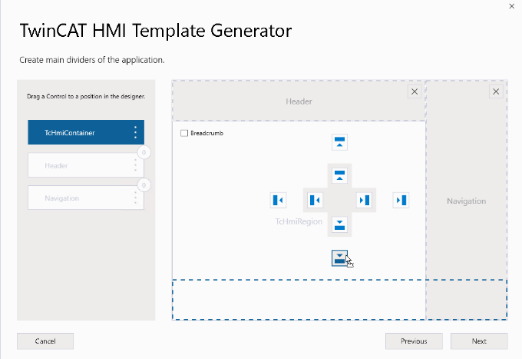
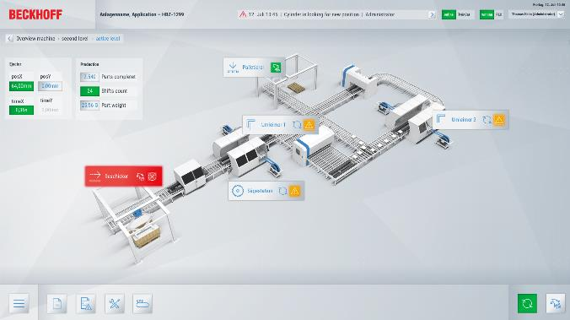

TwinCAT HMI | Features Project Generator
Graphical configurator
Different templates
Fixed resolution or responsive
Configure layout and navigation
UX design by experts
Preconfigured functionalities
User management (Client)
Event system
Theme selection

Slide 22
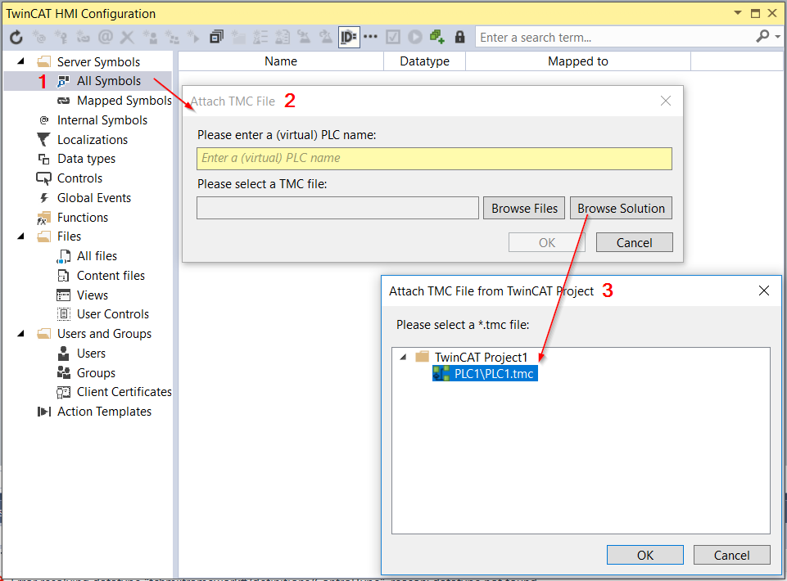
TwinCAT HMI | Engineering Variables
Online Engineering
Active ADS-Data available to map
Offline Engineering
TMC-Support for engineering without PLC connection
Load TMC-files and map variables offline
Switch to real PLC if connection is available

Slide 23
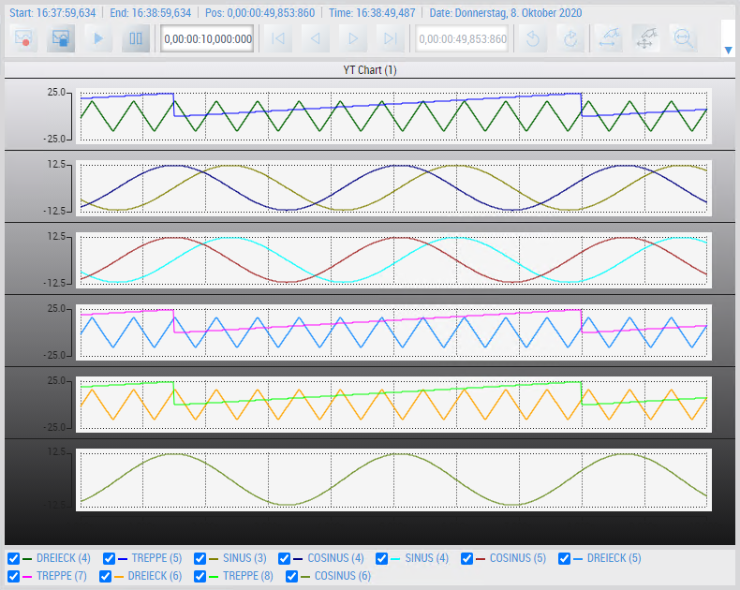
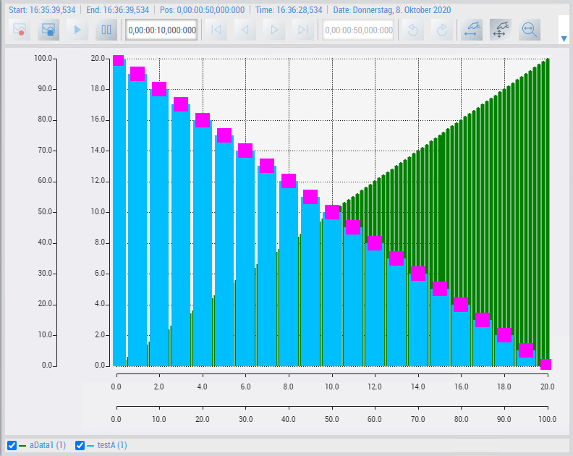
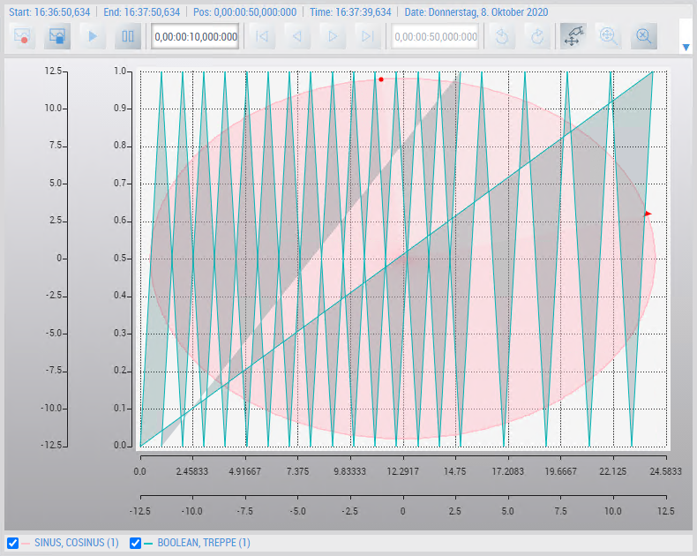
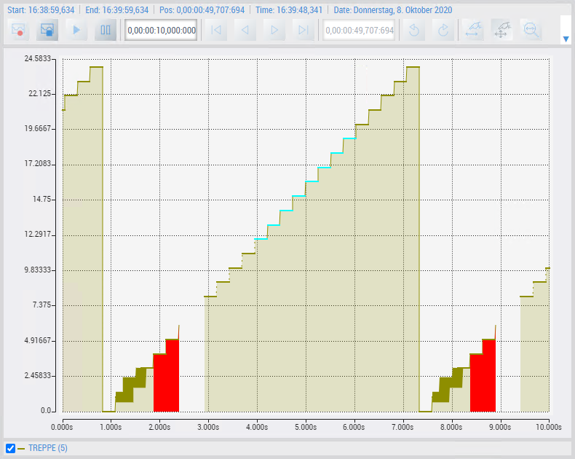
TwinCAT HMI | Engineering TwinCAT Scope Integration
Display of TwinCAT Scope Charts in HMI Client
Recording settings (start/stop)
Data analysis (zoom, move)
Available chart types: y(t), x(y), Bar, Array Bar
Import of existing Scope configurations
Included in HMI and Scope license

Slide 24
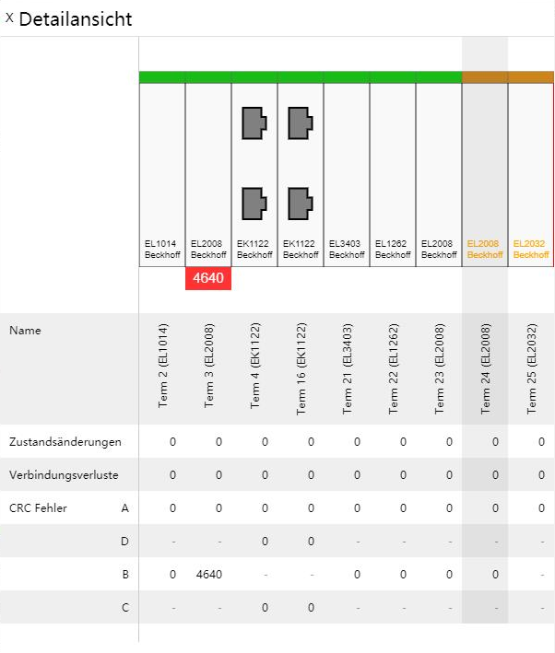
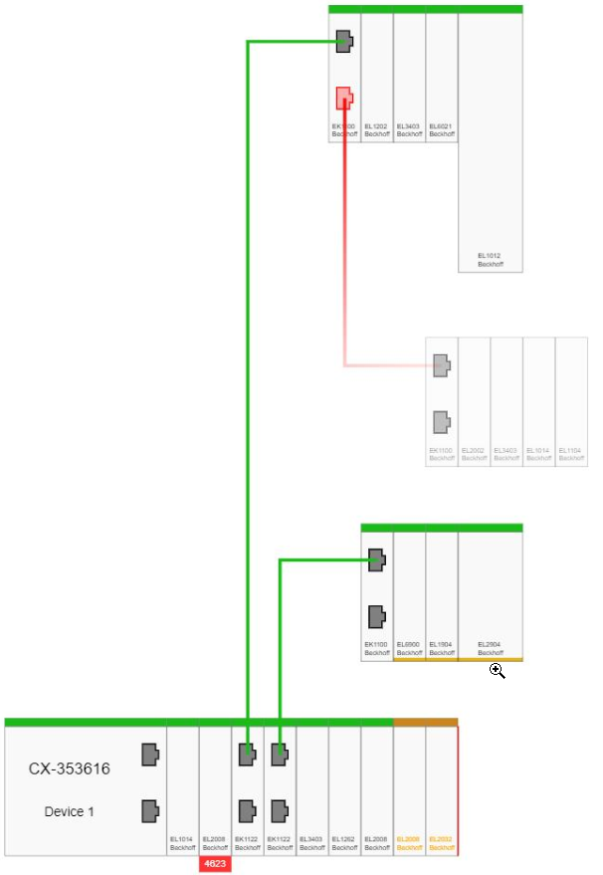
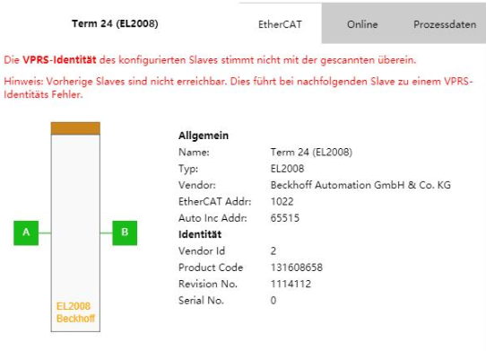
TwinCAT HMI | Engineering EtherCAT Diagnosis Control
Auto generated EtherCAT topology view for TwinCAT HMI
Provides detailed information of masters and slaves
Propose remedies in service case
Support features:
Hot Connect
Redundancy
Force process data inside the detail's popup
Included in TwinCAT HMI license

Slide 25
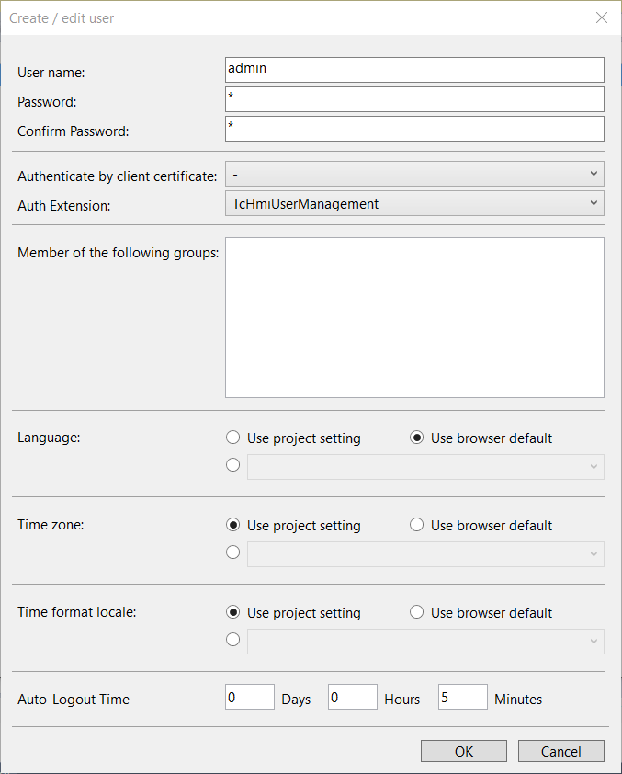
TwinCAT HMI | Features User Management
User Management server extension integrated
Create user groups and users
Dynamic editing and addition of users
User Management front-end control
Default Login page editable & option to add new custom login page
Permissions for controls, symbols, files
Complex controls can have permissions for individual nested controls

Slide 26
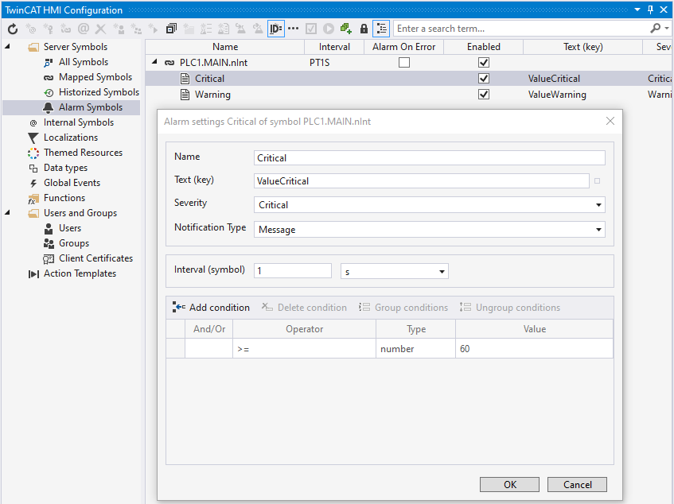
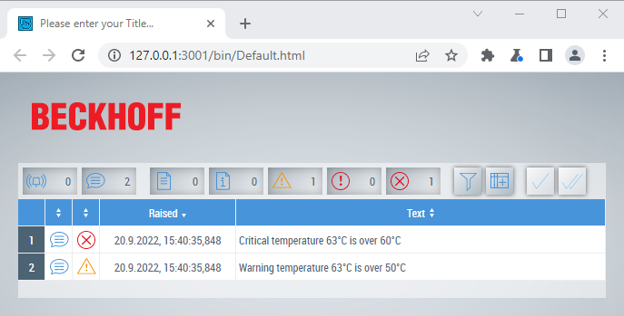
TwinCAT HMI | Features Alarm Extension
Use a symbol to generate an alarm
ADS
OPC UA
Custom Server Extension
EventGrid & EventLine support
Localized text support
Integrated in HMI Server
no running server, no events
update rate in fixed interval time

Slide 27
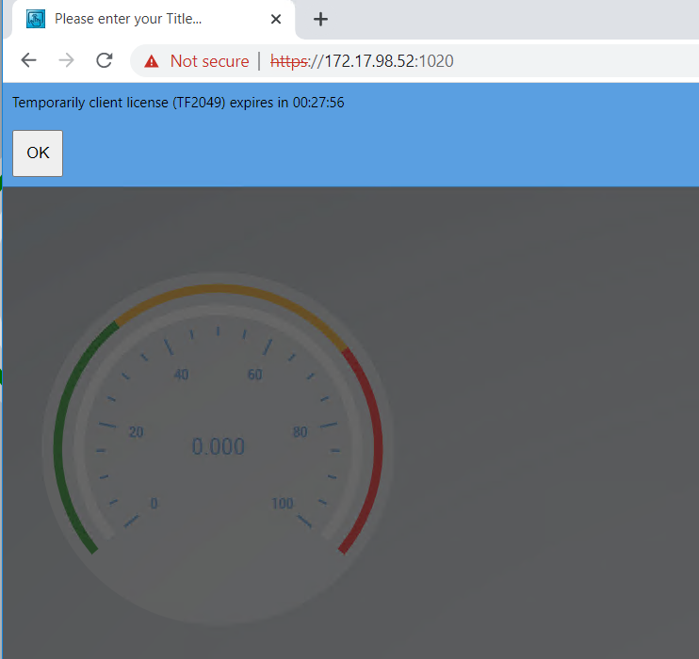
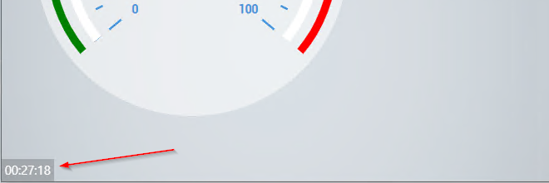
TwinCAT HMI | Features Time-based client license
New TF2049 “Time Based Clients” license
Free of charge
Use Case
Maintenance
temporary single client access if max. clients are reached
Limitations:
30 minutes access
5 minutes block time
countdown and banner
warning 5 minutes before block time

Slide 28
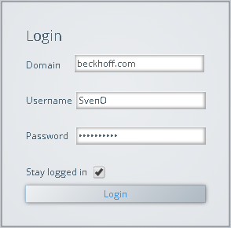

TwinCAT HMI | Features LDAP Extension
Support of Lightweight Directory Access Protocol
Connection to central user management (Active Directory)
Use OS credentials to log into HMI client
HMI Client
Group mappings
HMI Groups | LDAP Groups
Engineers | COMPANY\Engineers
Operators | COMPANY\Operators
Company.com
HMI Usermanagement
Active Directory
UserXY
HMI Server
HMI LDAP
Extension
LDAP
Server

Slide 29
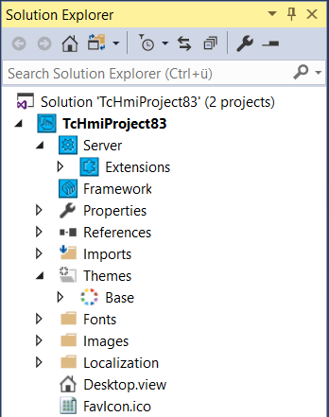


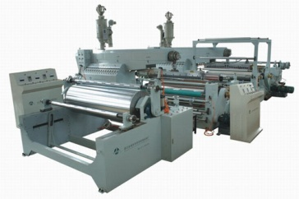
TwinCAT HMI | Features Automation Interface
Automatic generation of TcHmi projects
Comparable to TwinCAT Automation Interface
API to access most of the engineering functions
Program language independent – based on COM
Use Cases:
Automatic HMI deployment
Series machine builders
Project generation based on PLC code
…
create TcHmi project
deploy project on target Server
Automated task or plugin

Slide 30
TwinCAT HMI Agenda
Introduction
Engineering
Architecture
Scenarios
Products
Features
What’s New

Slide 31
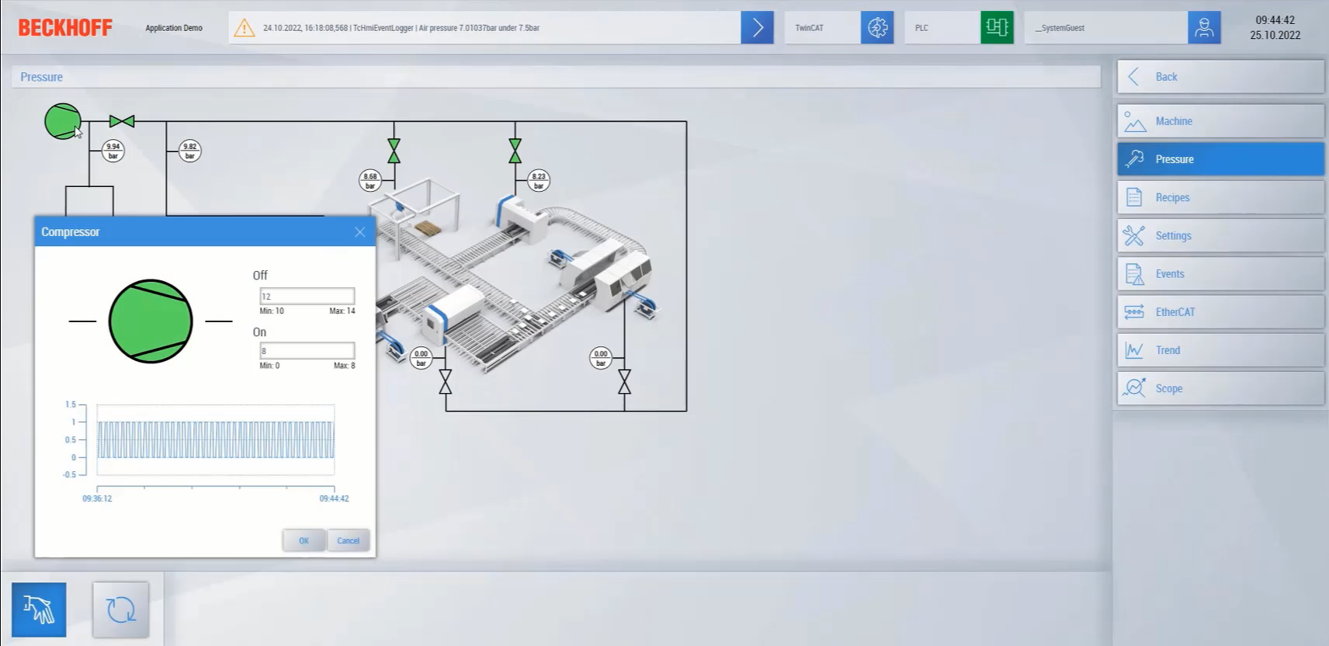
TwinCAT HMI What‘s New?
PopUp Controls
Opened and closed using functions triggered from other controls
Target file can be chosen dynamically
Draggable

Slide 32
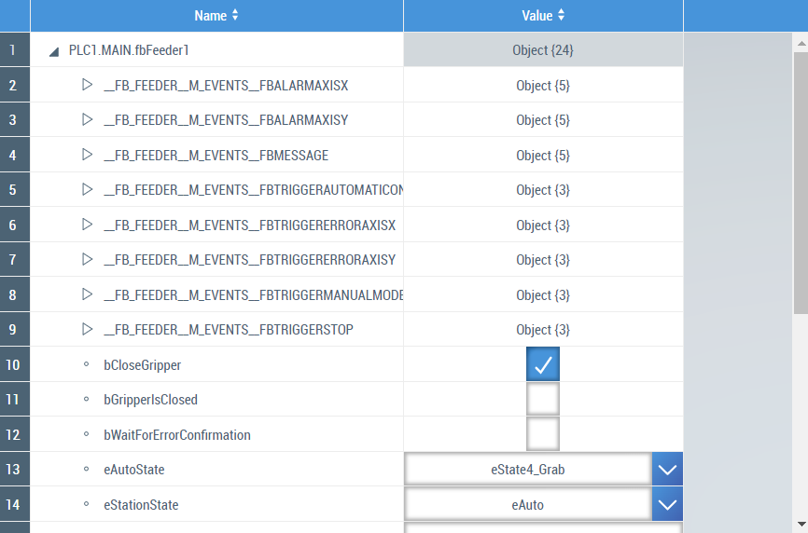
TwinCAT HMI What‘s New?
Object Browser
Read complex symbols from PLC
Tree structure displayed on HMI
Values of each nested parameter can be read / written

Slide 33
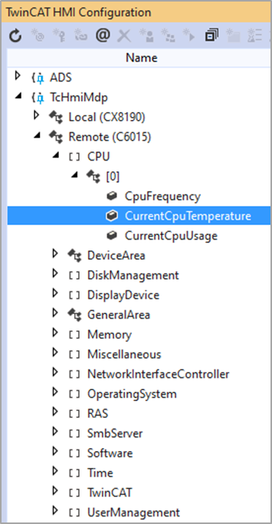
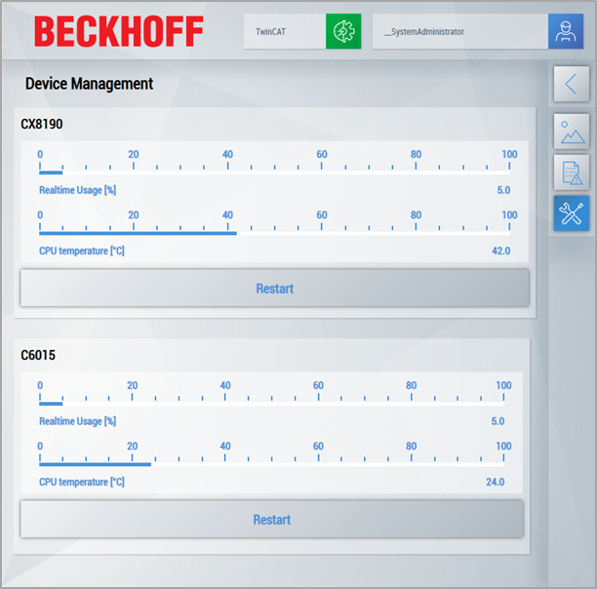
TwinCAT HMI What‘s New?
MDP Server Extension
Access to Modular Device Profile (MDP) of Beckhoff IPC Diagnostics
Can monitor PC status – CPU load, temperature etc. without PLC

Slide 34
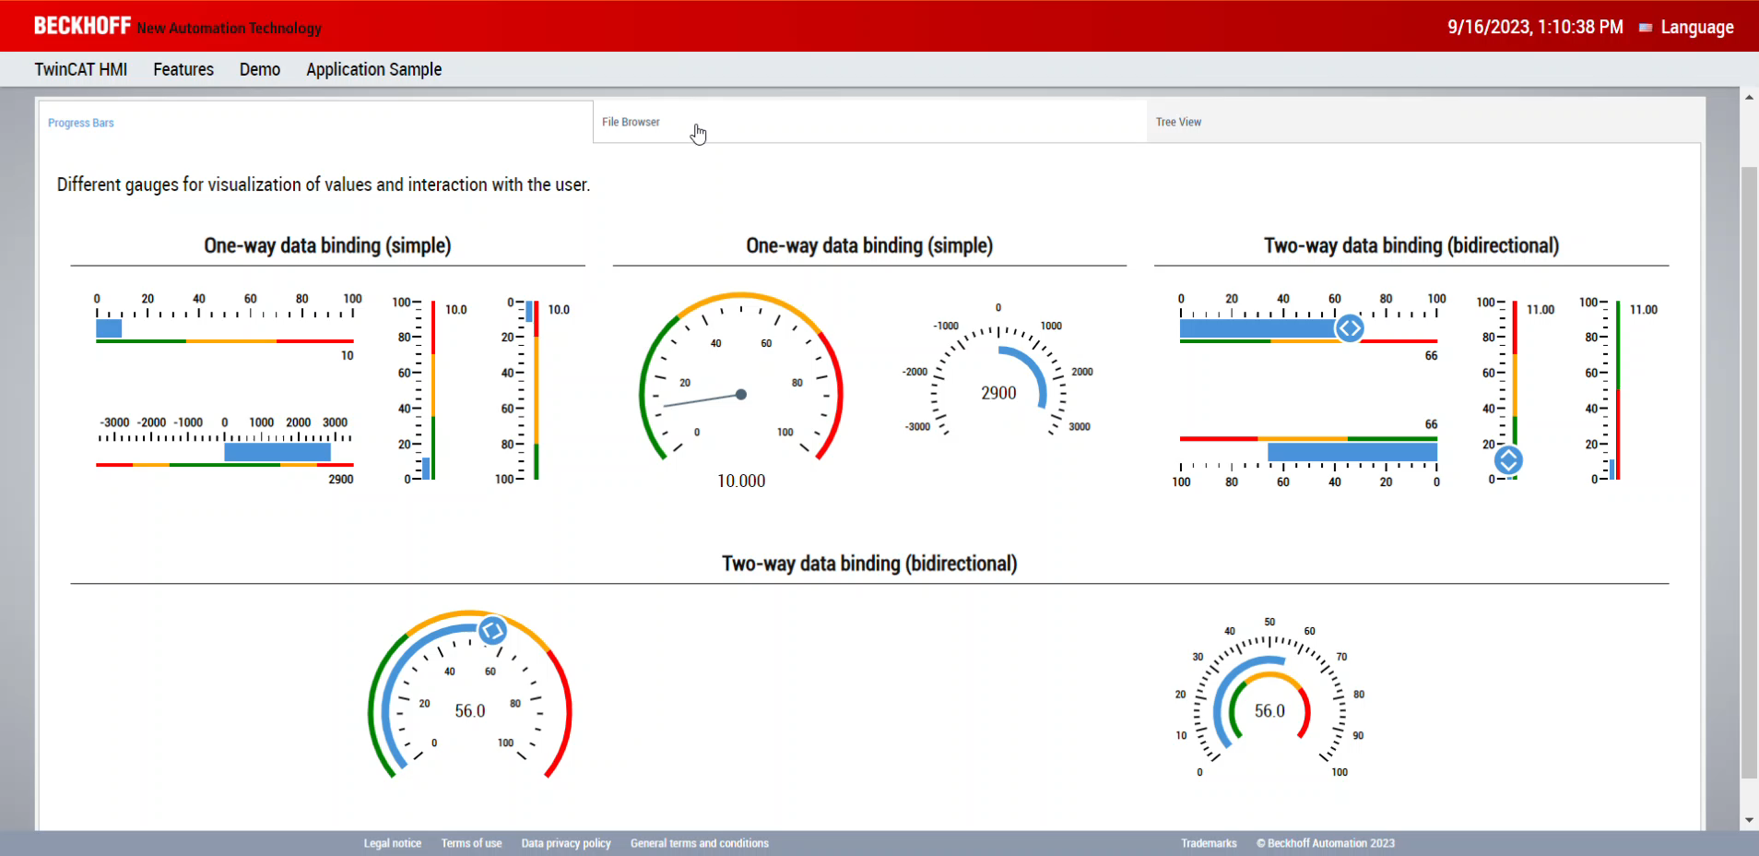
TwinCAT HMI What‘s New?
Tab Navigation
Control for page switching
Built-in tabs used to load different pages

Slide 35
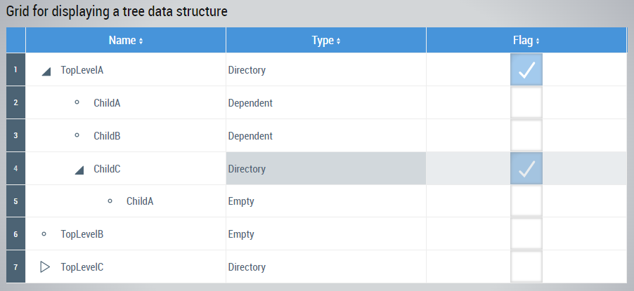
TwinCAT HMI What‘s New?
Tree View
Multi-column view for displaying data
Collapsible nodes

Slide 36
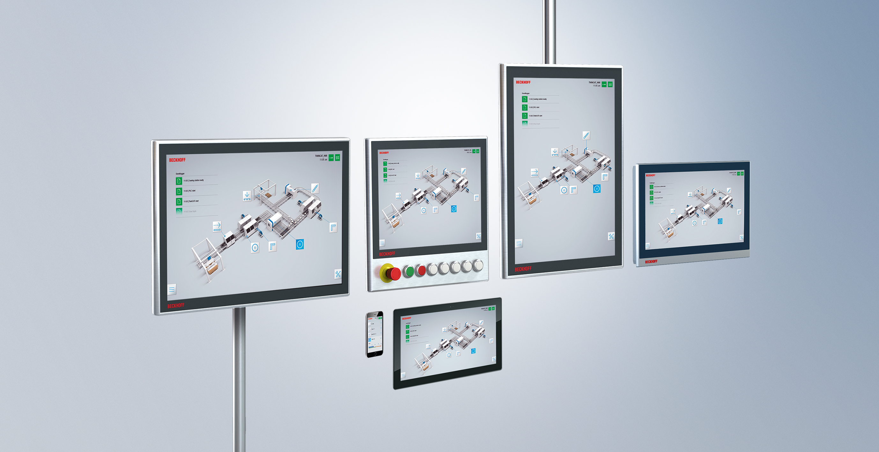
TwinCAT HMI Questions?

